Slide 1
STA/BST 222 Survival Analysis Lecture 18
Lihong Qi
Division of Biostatistics
Department of Public Health Sciences
School of Medicine
Dec 3, 2020

Slide 2
How to contact me
Email is best: lhqi@ucdavis.edu
Phone: 530-754-9234
Office hour: email for an appointment

Slide 3
How to contact TA
Xiner Zhou
Email: xezhou@ucdavis.edu
Office hours: 7:00pm – 8:00pm, Thursdays
Lab: 6:10-7:00 pm, Thursdays
For both Lab and OH, please use the zoom link with passcode: survival https://ucdstats.zoom.us/j/9681353237?pwd=ZzhLRHlhNG92bHFUaHkwM0Fib1pqQT09 Meeting ID: 968 135 3237

Slide 4
Focus
Review
Projects
Lab

Slide 5
Stratified Cox PH Model
Formula of a stratified Cox PH model
Assumptions
Each of the G groups has it’s own baseline hazard function.
But with same regression coefficients, i.e. hazard ratio same for each stratum. (no interaction assumption)
Stratification of predictors not satisfying PH assumption
Includes predictors satisfying PH
Does not include stratified variables
Note: A single value for the hazard ratio for the stratification variable is not appropriate if it doesn’t satisfy the PH assumption, because the hazard ratio varies with time.

Slide 6
Partial likelihood
Note:
The fitted stratified Cox model will yield different estimated survival curves for each stratum because the baseline hazard functions are different for each stratum.

Slide 7
What did we learn?
A brief review

Slide 8
What’s survival data?
Survival data consists of an event (binary) and time to the event (continuous).
Event time T, censoring time C, event indicator delta=I(T observed) = I(event observed)
Assuming right censoring, observed time X = min(T, C)
(X_i, delta_i), i=1,…, n iid
Key difference: two components and not all event times can be observed.

Slide 9
Censoring and truncation
Censoring: A censored observation arises when the exact failure time is unknown, but we know whether the event happened or not. We have partial information of a censored subject.
Truncation: A truncated observation is one which is unobservable due to a selection process inherent in the study design, ie., we only observe those with event times falling in a time window. We do not have any information about the truncated subjects.

Slide 10
Typical Censoring Mechanisms
Right censoring: T > C, T not observed
Type I censoring: prespecified censoring time
Type II censoring: prespecified number of events
Random censoring: censoring time is random, our focus
Left censoring: T < C, T not observed
Interval censoring: T is in an interval, unknown
A critical assumption in survival analysis: the failure times and censoring times are independent

Slide 11
How to describe survival data?
Survival function S(t): the probability that the event of interest has not yet occurred by time t
Non-increasing function of time, falls in [0,1]
Hazard function (rate) h(t): instant risk of event at time t (conditional failure rate)
instantaneous potential for failure per unit time given survival up to time t
>=0, not a probability
Cumulative hazard function H(t): Cumulative risk up to time t
Mean survival time: mean time to the event
Median survival time: median time to the event
Mean and median survival time are functions of survival function

Slide 12
Relationship between survivor and hazard functions
Survivor and hazard functions can be converted into each other
h(t)=f(t)/S(t), where f(t) is the pdf of failure time.
H(t)=-ln[S(t)] => S(t) = exp(-H(t))
h(t)=dH(t)/dt = -d[ln(S(t))/dt]

Slide 13
Likelihood Construction
Step 1. identify the types of observations in the data
Step 2. write down the likelihood for each type
Step 3. assume independent observations, and independent censoring, write down the likelihood as the product of likelihood of all observations
When constructing a likelihood function for censored or truncated data, consider carefully what information each observation provides.
Impact of truncation: when data are truncated, need a conditional distribution in constructing the likelihood

Slide 14
Estimation
Life table analysis
Kaplan-Meier estimator
Nelson-Aalen estimator

Slide 15
Nonparametric methods for estimating survival function
Kaplan-Meier estimator for estimating survival function S(t).
Nelson-Aalen estimator for estimating cumulative hazard function H(t).
H(t)=-ln[S(t)] and S(t) = exp(-H(t))

Slide 16
Assumptions behind KM and NA estimators
KM and NA estimators do NOT specify distributional forms for survival functions.
Only assume independent censoring or truncation to obtain valid survival estimates.

Slide 17
Confidence interval vs confidence bands
CI: pointwise confidence intervals for the survival function are valid for a single fixed time point
CB: the survival function falls within the band for all t in [L(t ), U (t )], L(t) and U (t ) are the upper and the lower confidence bands.

Slide 18
CI and CB
Three ways:
Linear CI
Using a log transformed of the cumulative hazard rate H(t)
Using an arcsine-square root transformation of the survival function S(t)

Slide 19
Hypothesis testing
Based on comparing the Nelson-Aalen estimator
Using weighted differences

Slide 20
Tests
One sample log-rank test
W(t) = Y(t), # at risk
Two or more sample Log-rank test
W(t) = 1
Test for trend
Applied only when there is some a prior information that the alternatives are ordered.
Ordinal categorical factors
Stratified test
When need to adjust for another categorical factor

Slide 21
Modeling

Slide 22
Limitations with nonparametric method
Cannot handle continuous covariates
Cannot adjust for covariates
Cannot directly generate hazard ratio
Regression techniques to obtain adjusted survival curves.

Slide 23
Semiparametric proportional hazards model
Popular Cox proportional hazards model
Proposed by Cox (1972)

Slide 24
PH assumption and interpretation
Proportional hazards (PH): hazard rate is constant over time, so is proportional
θ=exp(β₁) interpretation: risk of having the event for an observation with Z1 relative to the risk of having the event for an observation with Z1*
Hazard ratio/relative risk: exp(β)
A relative risk measure
>1: increasing risk
<1: decreasing risk

Slide 25
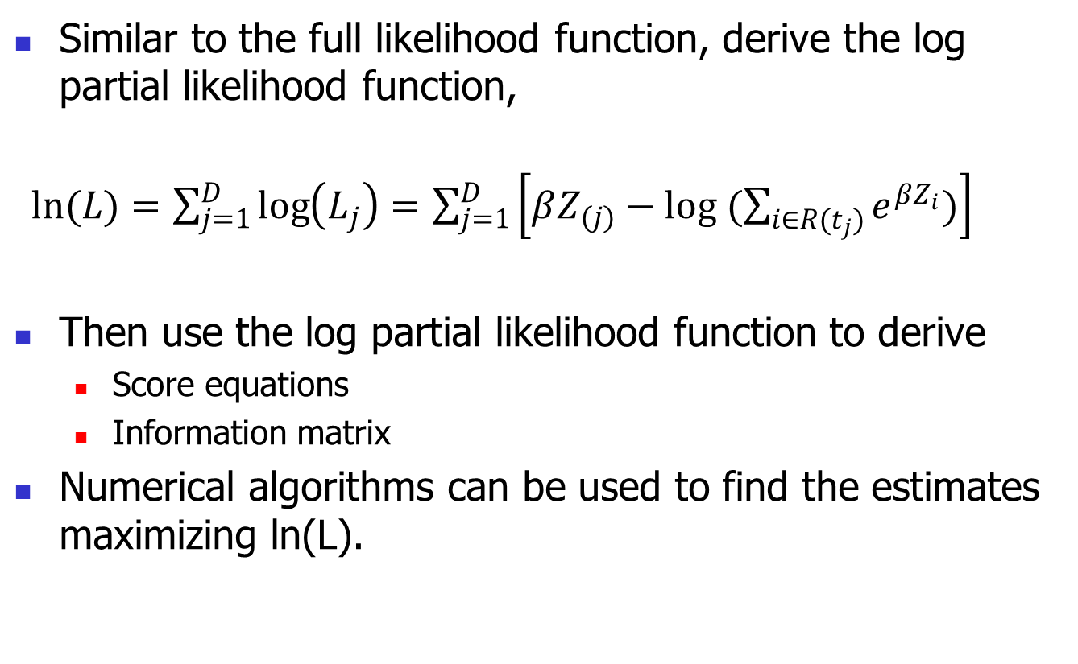
Estimation using partial likelihood
Similar to the full likelihood function, derive the log partial likelihood function, $⁡$
$ln(L)=\sum_{j=1}^{D}{\log\left(L_{j}\right)=\sum_{j=1}^{D}{\left[βZ_{(j)}−log (\sum_{i∈R(t_{j})}{e^{βZ_{i}}})\right]}}$
Then use the log partial likelihood function to derive
Score equations
Information matrix
Numerical algorithms can be used to find the estimates maximizing ln(L).

Slide 26
Hypothesis testing
Global test:
Local test
Only want to test a subset of regression coefficients.
Three ways:
Wald test
Likelihood ratio
Score test
Handle ties
Breslow’s method (1977)

Slide 27
Model building
To adjust for potential explanatory variables when one has a specific hypothesis, that is to compare two or more groups with respect to survival times
To predict the distribution of the time to some event from a list of explanator variables with no particular prior hypothesis in mind

Slide 28
Model building
Model building, variable selection
Forward selection
Backward selection
Stepwise
AIC/BIC/Likelihood ratio test for nested models
Purposeful Strategy
The model selection strategy depends to some extent on the purpose of the study.

Slide 29
Model diagnostics

Slide 30
Breslow’s estimator
Estimate the survival probability for a subject with a given set of covariates Z.
The estimator of the survival function is based on Breslow’s estimator of the baseline cumulative hazard rate.
Note: reduces to the NA estimator when

Slide 31
Residuals for Survival Data
Cox-Snell residuals to check overall fit of the model
Martingale residuals to check nonlinearity of a covariate
Deviance residuals to identify outliers
Score residuals to examine influential observations
Schoenfeld residuals to test PH assumption

Slide 32
Check PH assumption
Tests
Goodness of fit using Schoenfeld residuals
Testing X*g(t) in the Cox model
Graphics
Log-log(S(t)) (ie. log(H(t) )
KM
Observed vs expected
Schoenfeld residuals
PH assumption is supported by a random pattern with time and refuted by a non-random pattern

Slide 33
Extension of the Cox model
Stratified Cox PH model to address the PH violation
Different baseline hazard for each stratum
Assume same beta across different strata (no interaction of the stratification factor and the other covariates in the model)
Testing the assumption: likelihood ratio test of the models with and without interactions

Slide 34

Extension of the Cox model
Address left truncation
Modify the partial likelihood using the following risk set

Slide 35
Survival vs. other regression
Technique | Math Model | Yields
Linear Regression | Y=b0+b1*x+e (linear) | Linear changes
Logistic Regression | Log[p/(1-p)]=b0+b1x (sigmoidal probability) | Odds ratio
Survival Analysis | h(t)= h0(t)exp(b0+b1x) | Hazard ratio

Slide 36
Steps in conducting data analysis

Slide 37
Steps in conducting data analysis
Step 1: understand/define the questions, study design, and the type of data
What is the goal(s) of analysis?
Are the observations independent?
Are the comparison groups independent?
What is the type of outcomes/response variables?
Think about: what results to present? How to present the results? Tables? Figures?

Slide 38
Steps in conducting data analysis
Step 2: develop an analysis plan based on the goals, the design and the type of data
Define survival outcome and censoring (and truncation) mechanism; consider or define
What is the time scale?
What is the time origin?
What is the event of interest (based on the questions)?
What is the censoring (and truncation) mechanism (based on the study design and data collections)?

Slide 39
Steps in conducting data analysis
Step 3: data check, quality control and data cleaning
Using descriptive statistics and graphics
Continuous variables: means, std, median, interquartile range (IQR) (the third quartile – the first quartile), min, max for continuous
Categorical variables: frequency and %
Survival data: KM curves, mean and median survival time
Compare with data ranges/definitions in data codebook or dictionary to see whether there are discrepancies and/or errors.
Check whether the lowest and highest values are clinically feasible and valid for quality control
Look at missing data rate and pattern, censoring rate

Slide 40
Steps in conducting data analysis
Step 4: first look at data, all data and by comparison groups (e.g. treatment) using simple methods and graphics
Gain initial impression about the data and the simple comparison (t test/ANOVA/Chisquared/Fisher’s exact)
Consider whether data transformation is needed
Identify potential outliers (not proper to exclude them without scientific reasons)
Logrank tests for comparing survival curves (categorical predictors)
Cox model on one continuous predictor

Slide 41
Remarks on descriptive statistics
First, look at your data for potential problems (errors, outliers). Be sure to consider missing data as well as recorded.
Second, think of how to summarize: “Table 1”. Basic numerical descriptive summaries.
Third, look at the picture of the data: what does the picture tell you, and what problems might you have in analysis?
The simple data description reveals whether there is an interesting difference between comparison groups worthy of further statistical investigation

Slide 42
Steps in conducting data analysis
Step 5: model building and interpretation
Select proper analysis methods/models based on both statistical and scientific reasons
What covariates to include in the (Cox) model? interaction terms? Categorical or continuous version of a variable?
Need to be able to interpret your results, e.g. parameter estimates in the Cox model. If it does not make sense scientifically, reconsider your model.
Model diagnostics, especially, the PH assumption

Slide 43
Steps in conducting data analysis
Step 6: interpret results and write a report/paper.
What results to present?
How to present the results? Tables? Figures?
What do they mean? Can they answer your questions? How do they answer your questions?

Slide 44
Project 1
Project 1 (25%) will include the following tasks:
Identify a dataset
Specify the hypothesis
Define event and time and censoring/truncation mechanism
Propose appropriate survival analysis and then perform the analysis to analyze the data
Writing a final report using the Publication Manual of the American Psychological Association format (https://apastyle.apa.org/) (you can look at a paper in the journal to get a good idea of the format)
Include ALL software codes along with comments in Appendix.

Slide 45
Project 1
Report:
In the method section, describe in detail the primary analysis methods used, including assumptions, and theoretical derivation.
In the result section, include interpretations of your results
Students CANNOT collaborate on the project

Slide 46
Project 2
Project 2 (25%) will include the following tasks:
Identify a medical paper published in journals such as JAMA, JAMA Oncol, Cancer, Clinical Trials, Cancer Epidemiol Biomarkers Prev, Journal of the Academy of Nutrition and Dietetics, American Journal of Epidemiology, American Journal of Public Health.
Understand event and time and censoring/truncation mechanism in the paper and the primary hypothesis of the paper
Simulate the data using the values presented in the paper, with a combination of 3 categorical and continuous variables.
Analyze the simulated data using various methods you have learned and explain why you choose these methods.

Slide 47
Project 2
Derive formulas for the primary analysis method including assumptions.
Re-generate major results reported in the paper, including tables and figures.
Write a report using Statistics in Medicine format (https://onlinelibrary.wiley.com/page/journal/10970258/homepage/la_tex_class_file.htm) for Project 2
Include ALL software codes with comments in Appendix.
Students CANNOT collaborate on the project
An example of how to write about simulated data:
Qi L, Wang Y-F, He Y. A Comparison of Multiple Imputation and Fully Augmented Weighted Estimators for Cox Regression with Missing Covariates. Statistics in Medicine, 2010; 29(25): 2592-2604.
https://www.ncbi.nlm.nih.gov/pmc/articles/PMC4022355/

Slide 48
Notes
Presentation: choose one project for a 5 minutes presentation + 2 - 3 minutes of QA.
12/8, 12/10
First draft of reports of both projects will be due by 12/12/2020.
Final reports of both projects will be due by 12/18/2020
Final summary report (10%): review and summarize useful things you have learned in this course and how you have applied them and/or plan to apply them in your future research or career. Due by 12/18/2020

Slide 49
Data analysis
An example
https://www.ncbi.nlm.nih.gov/pmc/articles/PMC4430092/pdf/nihms-669269.pdf

